Slide 1

6 APRIL 2017
Better Health for Migrant Women
Why and How funders could make the difference
Chiara Benedetto
MD, PhD, FRCOG, FCNGOF, FEBCOG
Notes:
Rivedere logo con + contrasto

Slide 2
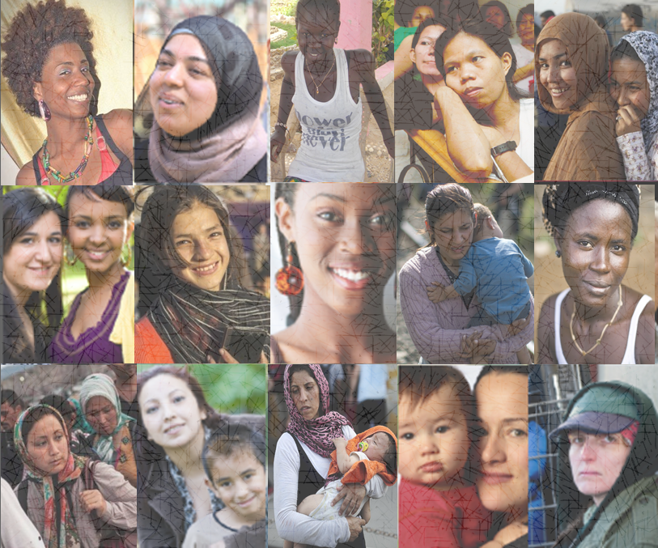
MIGRANT women may belong to various subgroups,
often with differing health needs and barriers to health

Slide 3
Migrant mortality rate in Europe
Ikram et al Eur J Epidemiol 2016
Denmark, England-Wales, France
Netherlands, Scotland, Spain
REGION OF ORIGIN
MORTALITY RATE RATIOS IN WOMEN
Adjusted for age and country of destination
Local-born population
reference
Eastern Europe
+
0.5
%
Caribbean
-
3
Other Latin American countries
-
44
South Asia
-
7
East Asia
-
24
North Africa
+
19
Sub-Saharan Africa
+
34
Turkey
-
0.4
Notes:
Allineare I + E I – (SIN) E I NUMERI TUTTI A DESTRA

Slide 4
Migrant mortality rate in Europe
Ikram et al Eur J Epidemiol 2016
Denmark, England-Wales, France
Netherlands, Scotland, Spain
REGION OF ORIGIN
MORTALITY RATE RATIOS IN WOMEN
Adjusted for age and country of destination
Local-born population
reference
Eastern Europe
+
0.5
%
Caribbean
-
3
Other Latin American countries
-
44
South Asia
-
7
East Asia
-
24
North Africa
+
19
Sub-Saharan Africa
+
34
Turkey
-
0.4
HEALTHY-MIGRANT EFFECT Selective migration of healthy individuals
SALMON BIAS Remigration of elder and unhealthy immigrants to native countries
Notes:
Allineare I + E I – (SIN) E I NUMERI TUTTI A DESTRA

Slide 5
Migrant mortality rate in Europe
Ikram et al Eur J Epidemiol 2016
Denmark, England-Wales, France
Netherlands, Scotland, Spain
REGION OF ORIGIN
MORTALITY RATE RATIOS IN WOMEN
Adjusted for age and country of destination
Local-born population
reference
Eastern Europe
+
0.5
%
Caribbean
-
3
Other Latin American countries
-
44
South Asia
-
7
East Asia
-
24
North Africa
+
19
Sub-Saharan Africa
+
34
Turkey
-
0.4
VULNERABLE POPULATION
Maternal mortality and gender-based violence
Possibile reasons:
Notes:
Allineare I + E I – (SIN) E I NUMERI TUTTI A DESTRA

Slide 6
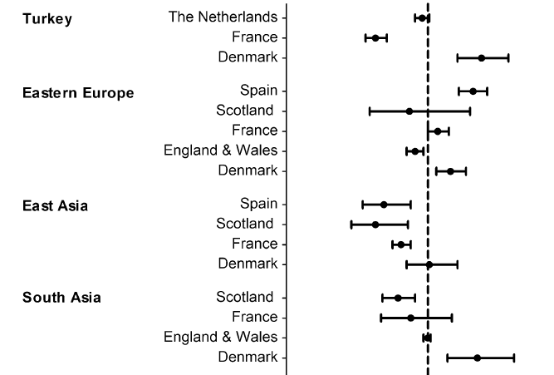
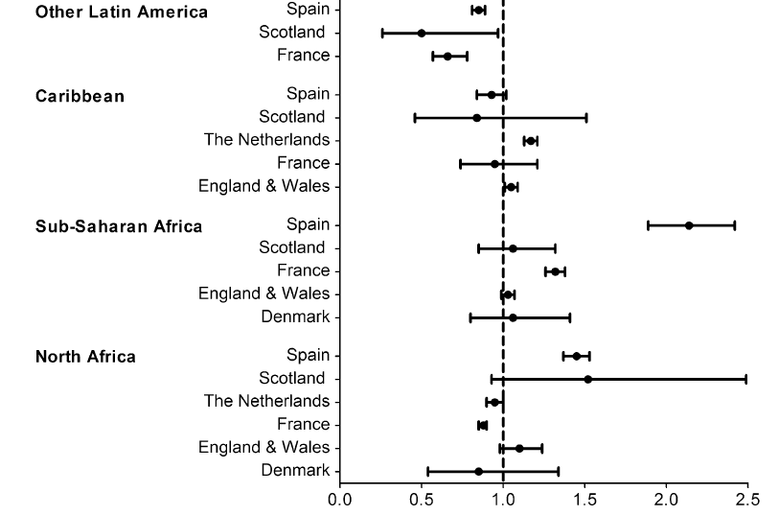
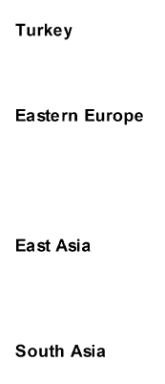
Migrant mortality rate in Europe
Ikram et al Eur J Epidemiol 2016
Denmark, England-Wales, France
Netherlands, Scotland, Spain
Age-adjusted mortality rate ratios (MRR) in women BY REGION of ORIGIN and COUNTRY of DESTINATION,
with local-born as the reference population
Local-born
Local-born
MRR- Women (95% CI)
MRR- Women (95% CI)

Slide 7
Migrant mortality rate in Europe
Ikram et al Eur J Epidemiol 2016
Denmark, England-Wales, France
Netherlands, Scotland, Spain
Age-adjusted mortality rate ratios (MRR) in women BY REGION of ORIGIN and COUNTRY of DESTINATION,
with local-born as the reference population
Local-born
Local-born
MRR- Women (95% CI)
MRR- Women (95% CI)
Notes:
Sottolineare stati

Slide 8
Migrant mortality rate in Europe
Ikram et al Eur J Epidemiol 2016
Denmark, England-Wales, France
Netherlands, Scotland, Spain
Age-adjusted mortality rate ratios (MRR) in women BY REGION of ORIGIN and COUNTRY of DESTINATION,
with local-born as the reference population
Such cross-country differences may reflect differences in the composition of that specific migrant population.
Local-born
Local-born
Local-born
Local-born
MRR- Women (95% CI)
MRR- Women (95% CI)
Notes:
Sottolineare stati

Slide 9

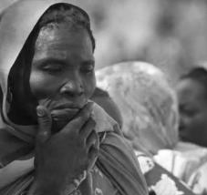
Migrant mortality rate in Europe
Ikram et al Eur J Epidemiol 2016
Denmark, England-Wales, France
Netherlands, Scotland, Spain
Age-adjusted mortality rate ratios (MRR) in women BY REGION of ORIGIN and COUNTRY of DESTINATION,
with local-born as the reference population
Such cross-country differences may reflect differences in the composition of that specific migrant population.
Local-born
Local-born
For example,
MOST MIGRANTS FROM SUB-SAHARAN AFRICA
residing in England and Wales, arrived as students, or as highly-skilled migrants,
whilst those living in Spain, entered Europe as refugees.
MRR- Women (95% CI)
MRR- Women (95% CI)
Notes:
Sottolineare stati

Slide 10
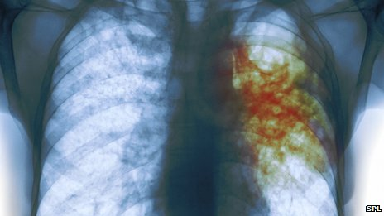


Migrant mortality in Europe
Ikram et al Eur J Epidemiol 2016
Denmark, England-Wales, France
Netherlands, Scotland, Spain
BY CAUSE of DEATH
Compared to the local-born populations, mortality due to
infectious diseases, mainly tuberculosis and HIV/AIDS, is higher
for most migrant populations, as is homicide.
Notes:
Immagine philadeplhia

Slide 11
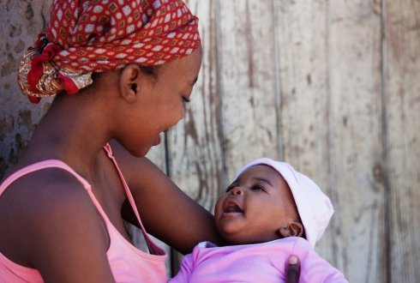
Sexual and Reproductive Health
Sexual Violence
Sexually transmitted infection
Contraception
Maternal and Infant Health
Notes:
Diapo passaggio scalette? STI Sexual violence Access to contraception Abortion Maternal and infant health

Slide 12

Sexual violence
Migrants of reproductive age in the WHO European Region are twice to three times
more at risk of sexual violence than the general population, with migration-related professionals, other nationals in migration centres and workplace superiors accounting for
up to 25% of the perpetrators
HEALTH EVIDENCE NETWORK SYNTHESIS REPORT 45 (2016)
“Migrants in Transit”
Sub-Saharan migrant women in transit from Morocco to Europe were interviewed: 45% of them reported cases of sexual violence, predominantly gang rape and/or sexual exploitation.
Keygnaert et al Globalization and Heath 2014

Slide 13
Sexual violence
“They took us to an olive tree field,
so they could do whatever they
wanted with us. They raped us. They
were seven. We were six girls, so you
can imagine….”
“He brought me to this man who gave me water, food and a shower. Then he told me that he helped many migrants, but that I would need to work like the others. I asked what I would do: he told me to be a prostitute and he would take the money.”
Beyoncé, a 23 yr-old from Cameroun
Agnès, a 28 yr-old from Rwanda
“Migrants in Transit”
Sub-Saharan migrant women in transit from Morocco to Europe were interviewed: 45% of them reported cases of sexual violence predominantly gang rape and/or sexual exploitation.
Keygnaert et al Globalization and Heath 2014

Slide 14

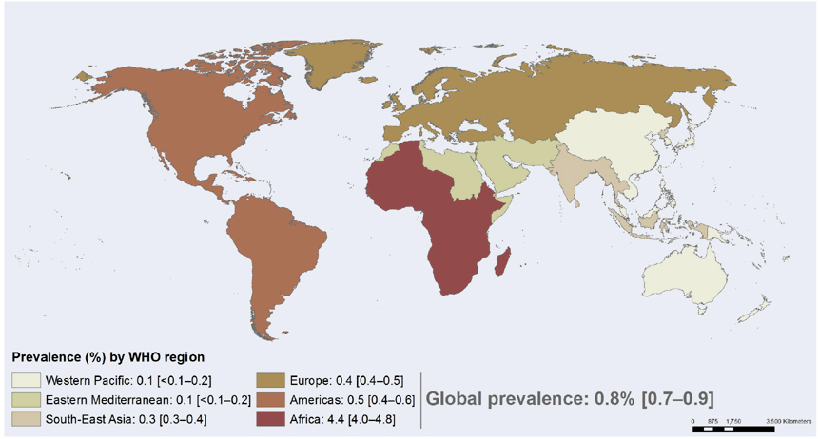
Sexually transmitted infections
http://www.who.org
Adult HIV prevalence (1-49 years), 2015 by WHO region

Slide 15
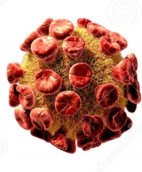
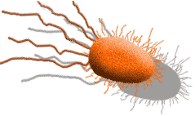
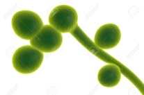
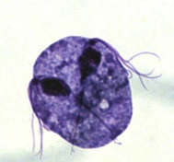
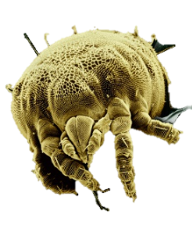
Sexually transmitted infections
http://www.who.int/mediacentre/factsheets/fs110/en/index.html
http://www.bashh.org
All sexually active individuals who are from COUNTRIES with a HIV RATE of >1%
should be offered a FULL SEXUAL HEALTH ASSESSMENT.
A high HIV rate in a country can be taken as an indicator of likely high rates of other sexually transmitted infections as well.
Notes:
Aggiustare testo

Slide 16
Sexually transmitted infections
http://www.who.int/mediacentre/factsheets/fs110/en/index.html
http://www.bashh.org
BACTERIA
VIRUSES
Syphilis
HIV
Chlamydia trachomatis
Human Papilloma Virus (HPV)
Neisseria gonorrhoeae
Hepatitis A,B,C
Gardnerella vaginalis, Mycoplasma hominis,
Ureaplasma urealyticum, Streptococcus B,
Stafilococcus aureus
Herpes Simplex type 1-2
HHV-8 Kaposi Sarcoma
Genital ulcera by Haemophilus ducreyi
Molluscum Contagiosum virus
Granuloma by Klebsiella granulomatis
PROTOZOA
MYCOSIS
PARASITES
Thricomonas Vaginalis
Candida Albicans
Pediculosis
Scabies

Slide 17
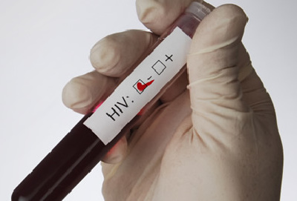
Sexually transmitted infections
http://www.who.int/mediacentre/factsheets/fs110/en/index.html
http://www.bashh.org
BACTERIA
VIRUSES
Syphilis
HIV
Chlamydia trachomatis
Neisseria gonorrhoeae
Therefore, sexually active individuals from countries at risk should be screened at a minimum with blood tests for HIV and Syphilis and urinary tests
for Chlamydia trachomatis and Neisseria gonorrhoea,
even if they do not have symptoms.

Slide 18
Sexually transmitted infections
http://www.who.int/mediacentre/factsheets/fs110/en/index.html
http://www.bashh.org
BACTERIA
VIRUSES
Syphilis
HIV
Chlamydia trachomatis
Human Papilloma Virus (HPV)
Neisseria gonorrhoeae
Hepatitis A,B,C
Moreover, all sexually active individuals, should be given advice on safer sex, contraception and screening for cervical cancer which is caused by some types of human papilloma viruses.
PROTOZOA
MYCOSIS
PARASITES
Thricomonas Vaginalis
Candida Albicans
Pediculosis
Scabies

Slide 19
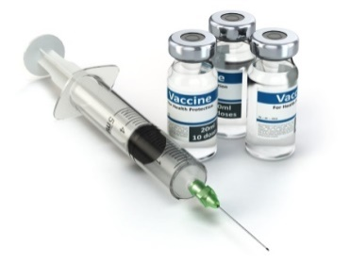
Sexually transmitted infections
http://www.who.int/mediacentre/factsheets/fs110/en/index.html
http://www.bashh.org
VIRUSES
Human Papilloma Virus (HPV)
Hepatitis A , B, C
Primary prevention of some serious consequences of sexually transmitted infections should, therefore, include VACCINES, for human papilloma viruses and also for hepatitis B.

Slide 20
Contraception use
Migrant women generally have a lower rate of contraceptive use than
non-migrant women
LC Poncet et al. Eur J Contracept Reprod Health Care (2013); E Wiebe. Can Fam Physician (2013); G Omland. BJOG (2014)
Contraceptive information for migrants that addresses existing knowledge gaps and other culturally relevant concerns needs to be enhanced
E Wiebe. Can Fam Physician (2013)
Notes:
Sistemare inglese

Slide 21
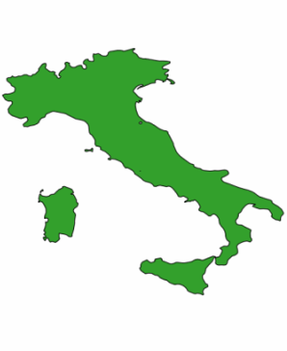
Counselling
during pregnancy & puerperium
Lauria et al. Ann Ist Super Sanità 2014
Health professionals should take every opportunity, such as during pregnancy, childbirth and puerperium to provide information and counselling to improve knowledge and awareness of contraception and other health issues
OPPORTUNITIES
to help migrant women to mix with local-born women and to get out their own environment,
to create relationships with other migrants,
to also involve males
The use of effective contraceptives in the postpartum period is similar (65%) between country born Italians and migrants
Notes:
Aggiugnere sotto cartina italia

Slide 22
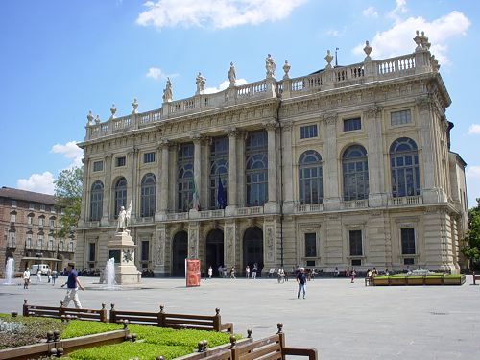


Project
“Born with Culture”

Slide 23


FOETAL PROGRAMMING
RISK IDENTIFICATION
INDIVIDUAL BIOMARKERS
ACTIONS
WINDOWS of OPPORTUNITIES
Birth
Foetus
FUNCTIONAL / STRUCTURAL REPROGRAMMING of the ORGANS
Decreased likelihood
of disease

Slide 24
Maternal Mortality
Pedersen et al Matern Child Health J 2014
Western Europe. A meta-Analysis
MIGRANT vs LOCAL-BORN WOMEN
RR(95% CI)
Overall maternal mortality
2.00 (1.72-2.33)
Direct maternal mortality
2.65 (1.88-3.74)
Death due to obstetric complications,
interventions, incorrect treatment
Indirect maternal mortality
1.83 (1.37-2.45)
Death due to previous existing diseases or diseases
that developed during pregnancy and which were not due to direct obstetric causes
MIGRANT women in Western European Countries have an EXCESS RISK
of maternal mortality, both from direct and indirect causes
Notes:
Fare il riquadro sotto con questo stile, vedere ombre sulle righe rosse

Slide 25
Maternal Mortality
Philibert et al. BJOG 2008
BY CAUSE
Metropolitan France
Foreign vs French
Adj OR for age (95% CI)
Total (all causes)
2.04 (1.51-2.77)
Haemorrhage
1.91 (1.03-3.55)
Hypertensive disorders
4.58 (2.31-9.08)
Amniotic fluid embolism
1.02 (0.36-2.91)
Infections
3.93 (1.17-13.15)
The MAIN CAUSES of increased maternal mortality in migrants include
hypertensive disorders, infections and haemorrhage
Notes:
Aggiungere punti su altri dati mancanti

Slide 26
Maternal Mortality
Philibert et al. BJOG 2008
BY CAUSE
Metropolitan France
Foreign vs French
Adj OR for age (95% CI)
Total (all causes)
2.04 (1.51-2.77)
Haemorrhage
1.91 (1.03-3.55)
Hypertensive disorders
4.58 (2.31-9.08)
Amniotic fluid embolism
1.02 (0.36-2.91)
Infections
3.93 (1.17-13.15)
This increased maternal mortality is partly related to suboptimal care probably as a consequence of COMMUNICATION PROBLEMS, such as failure or inability to report symptoms that may delay the administration of appropriate treatment or even lead to no diagnosis being made.
Notes:
Aggiungere punti su altri dati mancanti

Slide 27

Maternal Morbidity
Urquia et al. Eur J Pub Health 2015
IN THREE HIGH-MIGRATION SETTINGS
Canada (Province of Ontario), Australia (State of Victoria), Denmark
2,322,907 total deliveries, 479,986 (21%) in migrants
SEVERE MATERNAL COMPLICATIONS such as hypertensive disorders, haemorrhage and uterine rupture were higher in SUB-SAHARAN
AFRICAN WOMEN in all three receiving countries
Notes:
Cartina del mondo con canada australia e danimarca

Slide 28
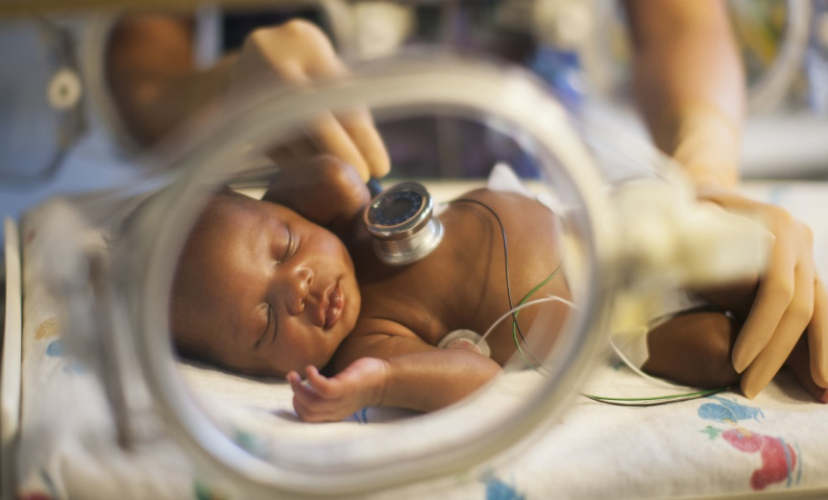
Preterm delivery
Gagnon AJ et al. Soc sci med 2009
Meta-analysis of 11 studies
THE RISK of PRETERM DELIVERY is significantly higher in
African – and Asian – born migrant women compared to that of the receiving country women

Slide 29
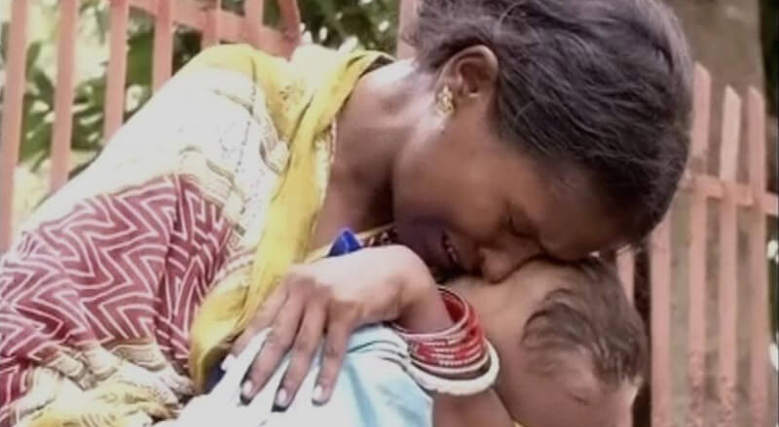
STILLBIRTHS and INFANT DEATHS
Gissler et al Acta Obstet Gynecol 2009
MORTALITY RISK in babies born to migrants is the greatest among refugees and non European migrants to Europe
Notes:
Bambino morto

Slide 30

POTENTIAL POLICY OPTIONS
Notes:
Rendere più generali le slides su potential policy options, verificare se ci sono dati sul 2016. Vedere slide che erano state eliminate dalla ppt

Slide 31
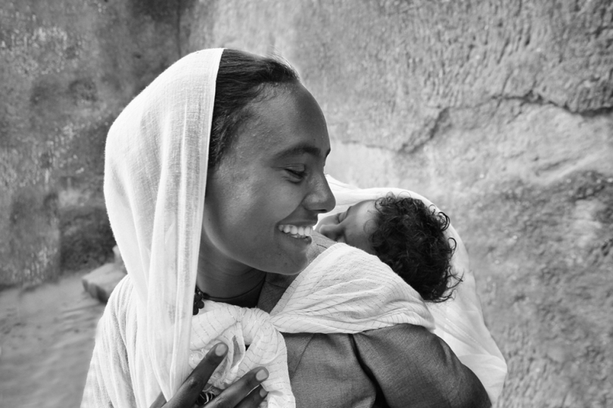
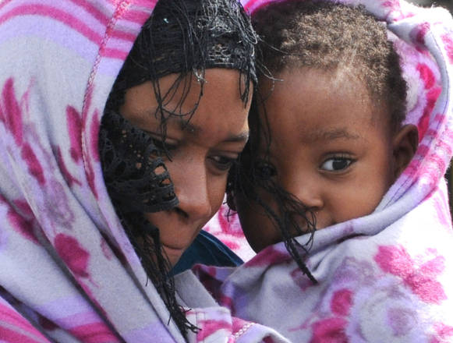
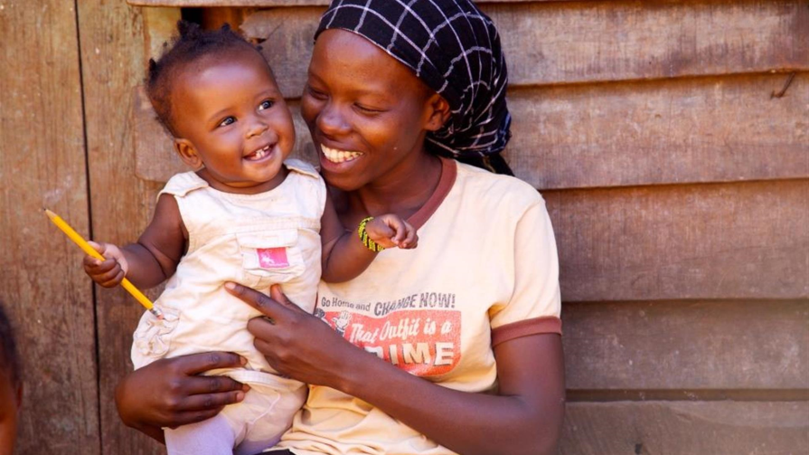
The MASSIVE SURGE in MIGRANTS ENTERING EUROPE poses
EXTRA CHALLENGES
Notes:
Rivedere fascia azzurra, extra challenges più grande o su una riga sola

Slide 32
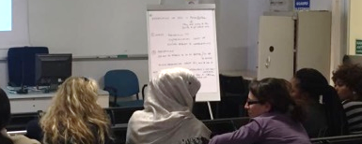
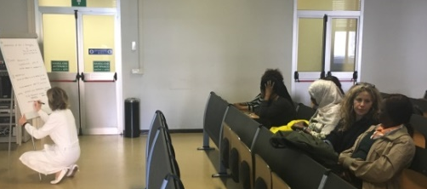
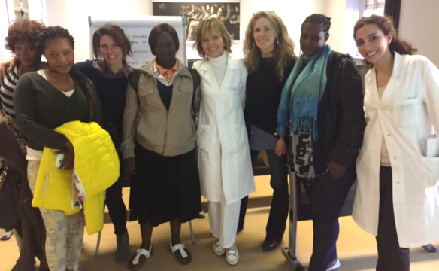
What migrant women said
Notes:
Provare a fare a scritte azzurre con riquadri e scritte.

Slide 33
What migrant women said
What do you think about the health care you have been given so far in Italy?
“We are happy about Italian National Health Service”
Appreciation of Italian National Health Service vs African System (they send money to their families to get medical care)
Notes:
Provare a fare a scritte azzurre con riquadri e scritte.

Slide 34
What migrant women said
What are the most important needs, as far as health is concerned, for women coming from other countries?
Gynaecological check-up
Information on prevention of sexually transmitted diseases and on contraception
in a form they can understand.
They wanted men also to be informed
Information about the National Health System, how they can use it and where to go
Notes:
Provare a fare a scritte azzurre con riquadri e scritte.

Slide 35
What migrant women said
When and how information about health should be given to migrant women?
Immediate and compulsory chek-up on arrival
Counselling on not being afraid of going to hospital or seeing a doctor
Information on priority areas of prevention should be given to men and women
both immediately and later in more detail through meetings with professionals
and written material to keep
Notes:
Provare a fare a scritte azzurre con riquadri e scritte.

Slide 36
What migrant women said
When asked about their knoweldge of the anatomy of their genital tract,
cervical cancer prevention, HPV vaccines and the importance of
pre-conceptional counselling….
The said they knew NOTHING at all and WANTED to LEARN ABOUT IT
Notes:
Provare a fare a scritte azzurre con riquadri e scritte.

Slide 37
Following their feedback
increased meetings with pregnant and non-pregnant migrant and local-born women
WORD of MOUTH DISSEMINATION to OTHER WOMEN
Notes:
Provare a fare a scritte azzurre con riquadri e scritte.

Slide 38

PROMOTING and INVESTING in FAMILY PLANNING CAN BE A COST–EFFECTIVE
way to improve migrant women’s health and prevent unintended pregnancies
HEALTH EVIDENCE NETWORK SYNTHESIS REPORT 45 (2016)
Notes:
Aumento interlinea sopra e carattere o su 3 righe

Slide 39

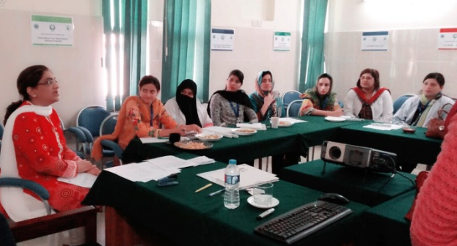
EDUCATIONAL MATERIAL is to be provided in a CULTURALLY SENSITIVE way and INTERPRETERS and OTHER SUPPORTIVE SERVICES must be offered
TRAINING PROFESSIONAL STAFF on issues such as intercultural communication,
culturally sensitive care and specific female health risks in migrants is to be encouraged
to favour the provision of CULTURALLY SENSITIVE CARE
INCREASED NUMBER OF WORKSHOPS around the world
Notes:
Rivedere interlinea provare due fasce. Immagine sovrapposizione

Slide 40
  A difference can be made by adopting an approach where
  human rights are fully integrated into women’s healthcare
Health
Life
Benefit from Science
Confidentiality
Information
Privacy
Autonomy
Decision making
Non-discrimination
Family Size and Spacing
Freedom from inhumane treatment

Slide 41


2015-2030

Slide 42
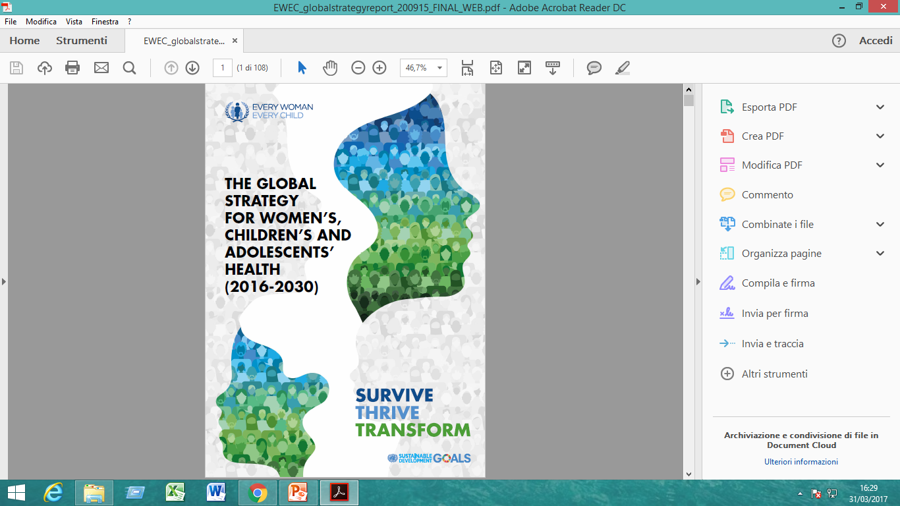

Slide 43
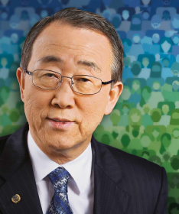
THE GLOBAL
STRATEGY
FOR WOMEN’S,
CHILDREN’S AND
ADOLESCENTS’
HEALTH
(2016-2030)
Ban Ki-moon
“…By helping to create an enabling environment for health, the GLOBAL STRATEGY aims to transform societies so that women, children and adolescents everywhere can realize their rights to the highest attainable standards of health and well-being.
This, in turn, will deliver enormous social, demographic and economic benefits”
“It is a grand vision. But it is achievable.”

Slide 44
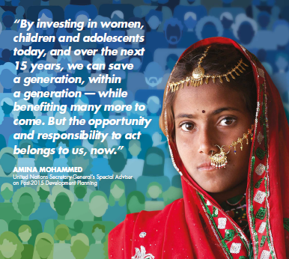
THE GLOBAL
STRATEGY
FOR WOMEN’S,
CHILDREN’S AND
ADOLESCENTS’
HEALTH
(2016-2030)
We all have a role to play
The opportunity and reponsability to act belong to us, NOW.
The Global Strategy can only be implemented through collective action and collaborative effort: everyone has a critical role to play in improving the physical and mental health of women, children and adolescents, everywhere.

Slide 45


